Slide 1
Gulf Boulevard Pedestrian/Bicycle Safety Study
Indian Rocks Beach Commission Meeting
February 12, 2019

Slide 2
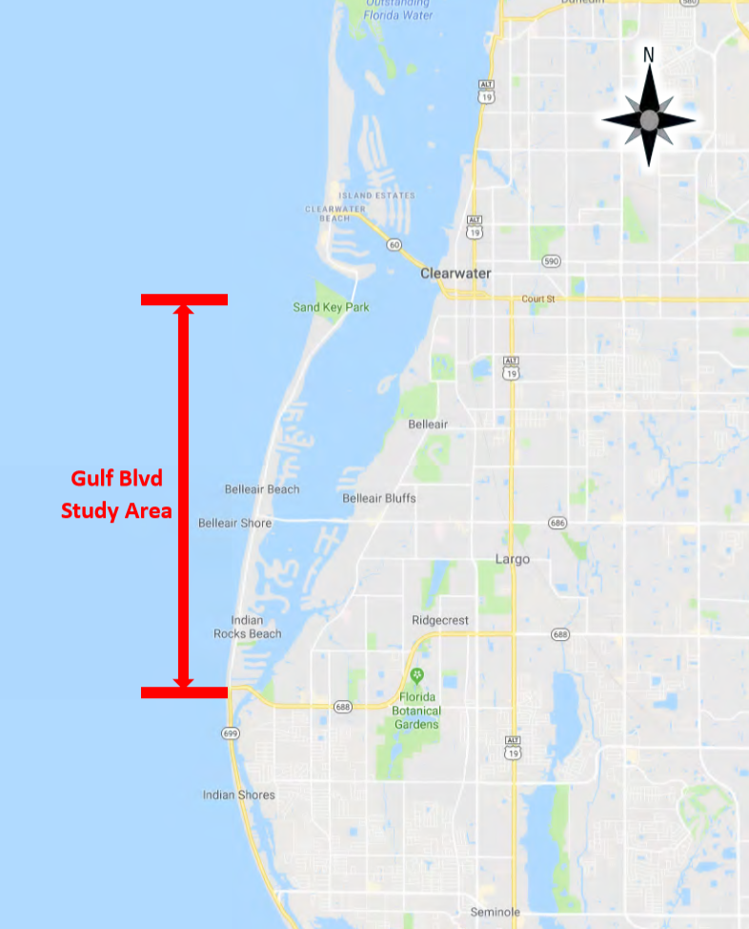
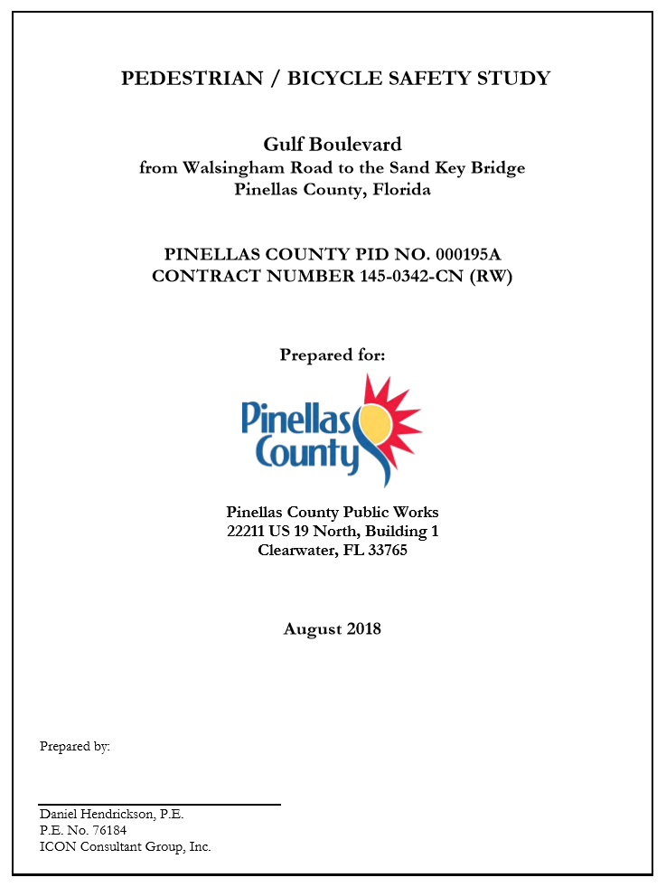
Gulf Boulevard Pedestrian/bicycle Safety Study
Walsingham Rd to Sand Key Bridge
Study Completed August 2018
Follow Up to 2013 Study
Reevaluation of Corridor
Consistency between County and State Sections

Slide 3
Gulf Boulevard Pedestrian/bicycle Safety Study
Presented to Indian Rocks Beach Commission October 2018
Tonight’s Presentation
Overview of Indian Rocks Beach Section
Recommendations
Costs and Funding
Schedule

Slide 4
Gulf Boulevard Pedestrian/bicycle Safety Study
Pedestrian/Bicycle Volume Count
Crash Analysis
Field Observations
FDOT’s Traffic Engineering Manual
Florida Design Manual
Manual on Uniform Traffic Control Devices

Slide 5
Gulf Boulevard Pedestrian/bicycle Safety Study
Recommendations
Install New and/or Remove Existing Crosswalks
Side Street High Emphasis Crosswalk Striping
Modify existing lane widths for standard bike lanes
Install green bike lanes along the corridor (not within Indian Rocks Beach)
Wayfinding Side Street Signage

Slide 6
Gulf Boulevard Pedestrian/bicycle Safety Study
Walsingham Rd to 28th Ave
30 MPH
18,000 vehicles per day
Crash Data 2013 – 2017
Pedestrian 3
Bicycle 11
Heavy Crossing Activity
Walsingham Rd
7th Ave
8th Ave
9th Ave to 18th Ave
24th Ave to 28th Ave

Slide 7
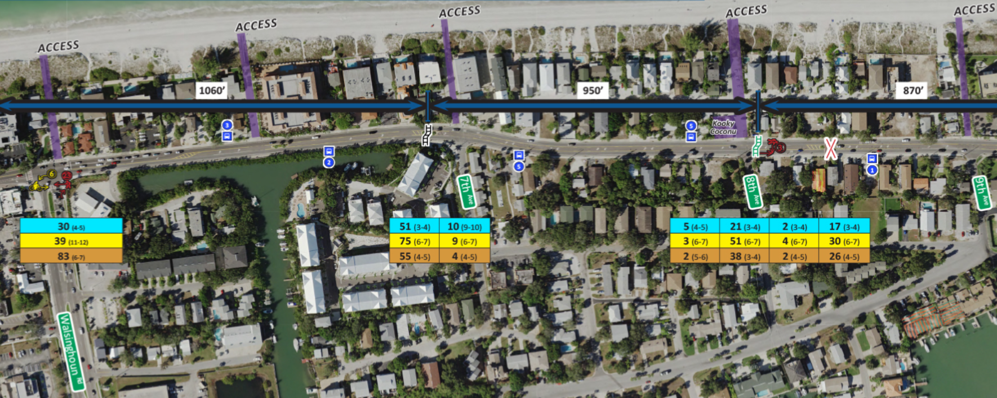
South of 7th Avenue – Remain
8th Avenue – New
Between 8th and 9th Avenue – Remove

Slide 8
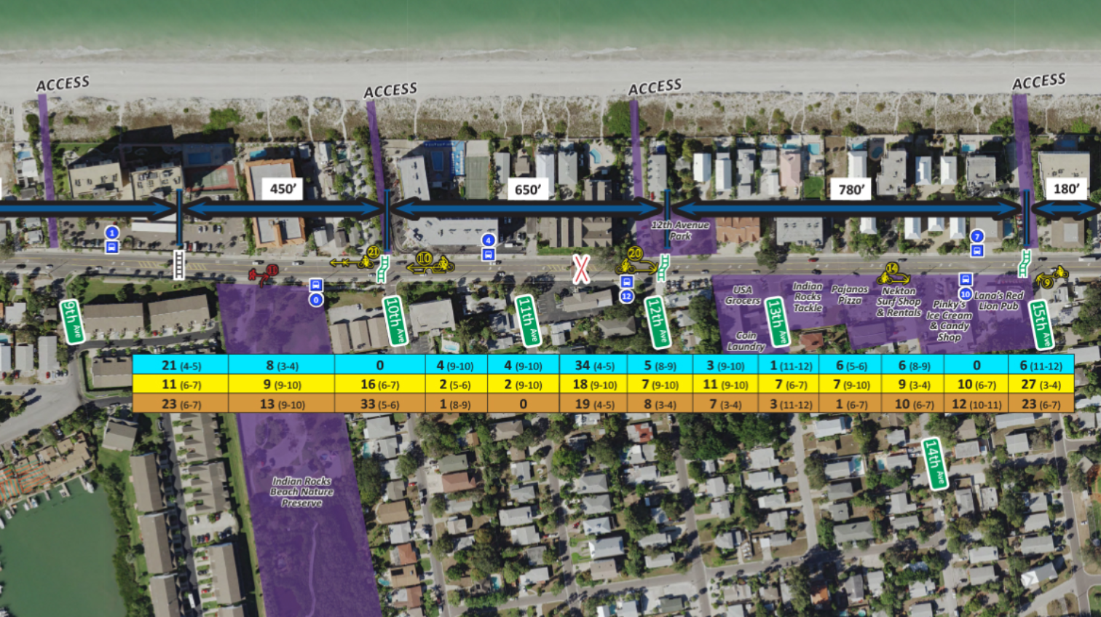
North of 9th Avenue – Remain
10th Avenue – New
Between 11th and 12th Avenue – Remove
12th Avenue – New
15th Avenue – New

Slide 9
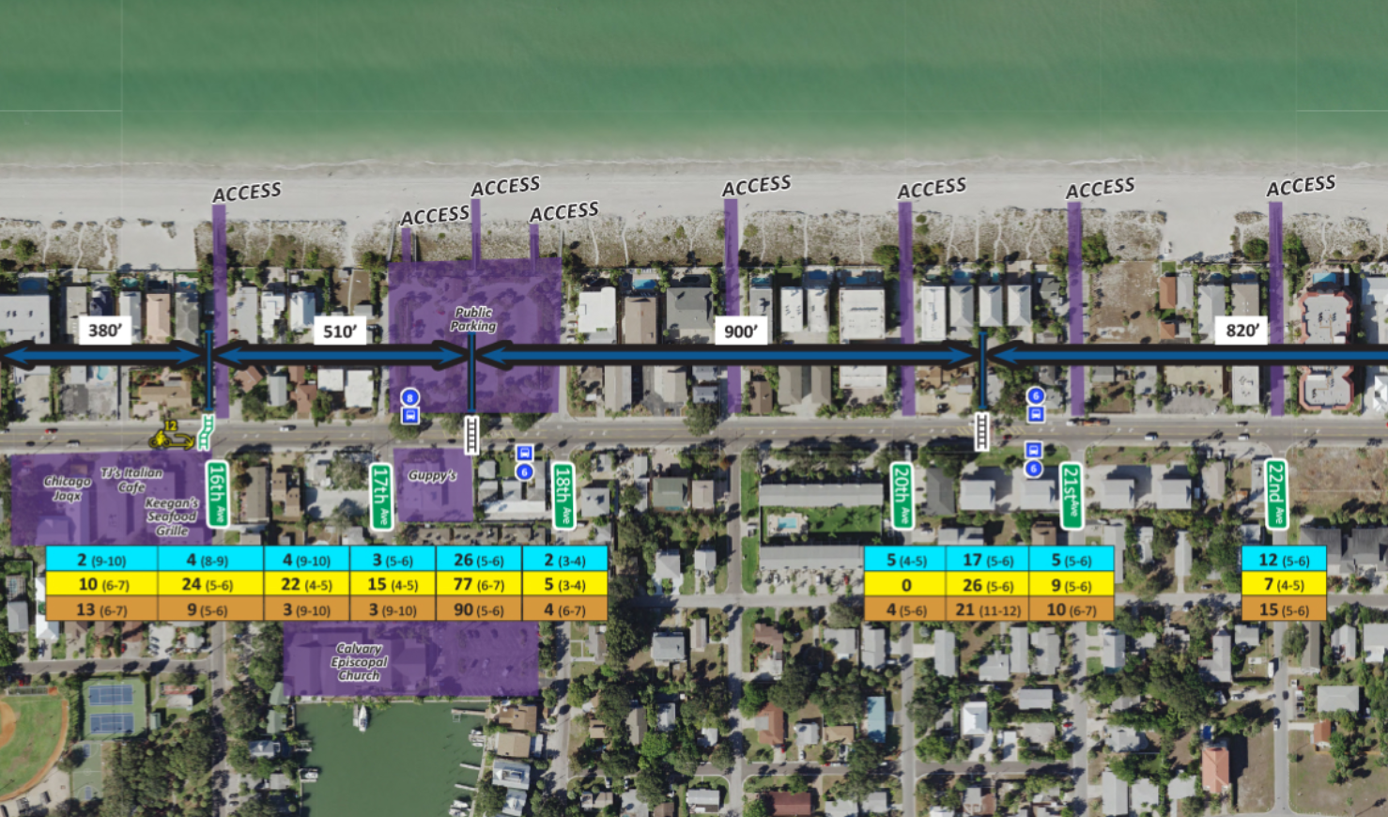
16th Avenue – New
Between 17th and 18th Avenue – Remain
Between 20th and 21st Avenue – Remain

Slide 10
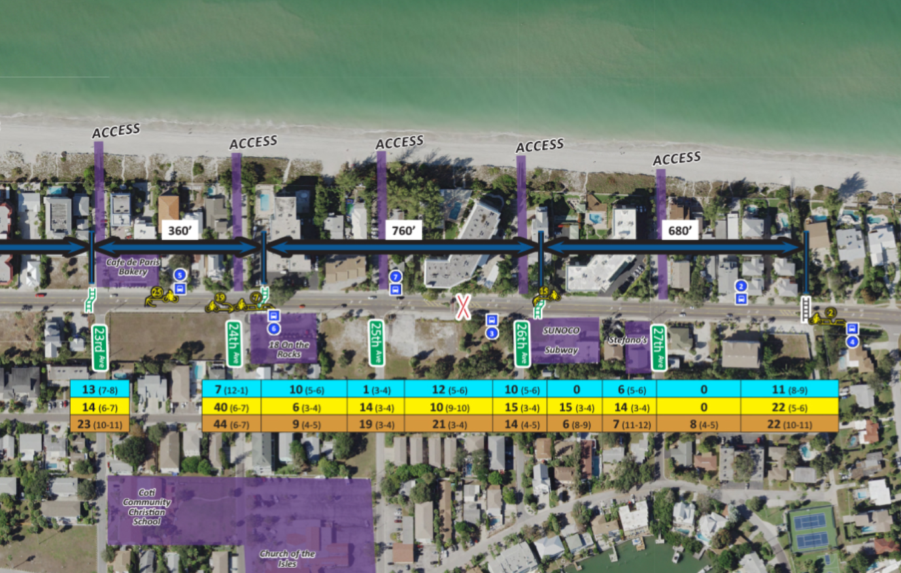
23rd Avenue – New
24th Avenue – New
Between 25th Avenue and 26th Avenue – Remove
26th Avenue – New
28th Avenue - Remain

Slide 11
Gulf Boulevard Pedestrian/bicycle Safety Study
Remove 3 Existing Crosswalks Cost $20K Each
Funding Sources
County - Remove Pedestrian Features and Median opening
To Reduce Costs, the Median will Remain

Slide 12
Gulf Boulevard Pedestrian/bicycle Safety Study
Installation of 8 New Crosswalks Cost $86K Each
Funding Sources
FDOT - Rectangular Rapid Flashing Beacons (RRFBs)
County - Raised Median Islands, Curb Ramps, Signage
City - Landscaping, Irrigation, Lighting, Decorative Pavement (Not included in the cost above)

Slide 13
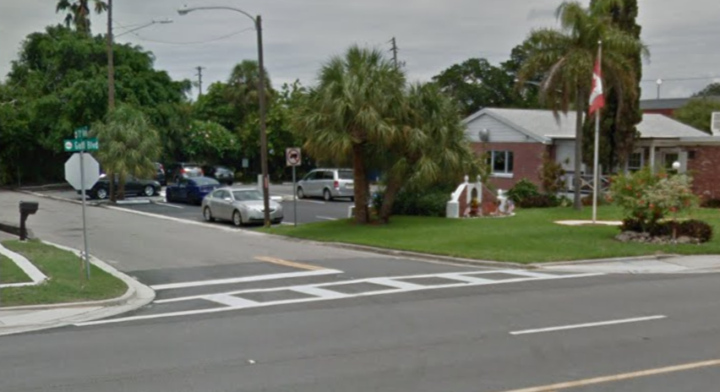
Gulf Boulevard Pedestrian/bicycle Safety Study
21 Side Street High Emphasis Crosswalk Striping Cost $900 Each
Funding
County

Slide 14
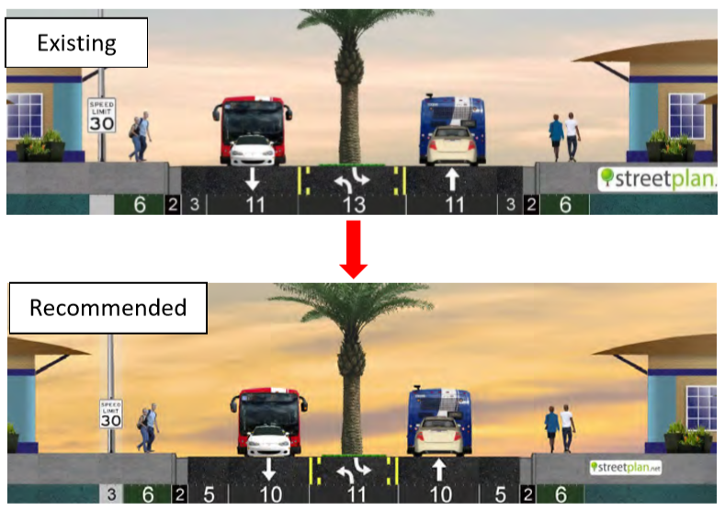
Gulf Boulevard Pedestrian/bicycle Safety Study
Modify 1.8 Miles Existing Lane Widths for Standard Bike Lanes Cost $140K Per Mile
8 Median Widths reduced Cost $12K Each
Funding
County to Consider During Next Resurfacing Cycle

Slide 15
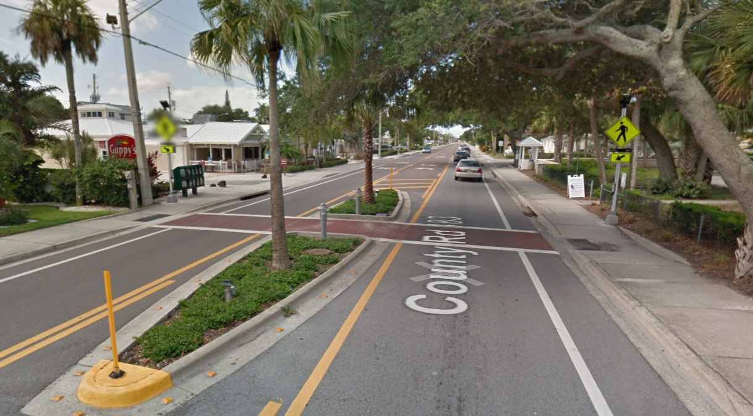
Gulf Boulevard Pedestrian/bicycle Safety Study
Cost Summary
Remove 3 Crosswalks $60K
Install 8 Crosswalks $688K
21 Side Street Crosswalks $19K
1.8 Miles Travel Lane Width $252K
8 Median Modification $96K
Total $1.1M

Slide 16
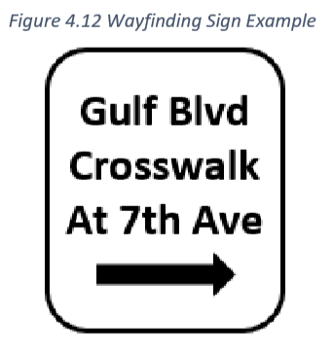
Gulf Boulevard Pedestrian/bicycle Safety Study
Wayfinding - Install Signs and Pavement Markings to direct pedestrians to nearby crosswalks
Funding
City Design and Install

Slide 17
Gulf Boulevard Pedestrian/bicycle Safety Study
Schedule
Short Term / Long Term
Coordination
Design
Funding
Construction

Slide 18
Gulf Boulevard Pedestrian/bicycle Safety Study
Questions?

